Slide 1
Soil
It’s Alive!!!!!!

Slide 2
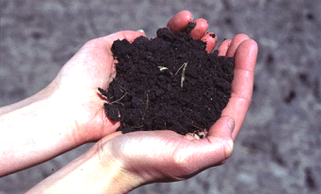
What is soil?
Soil is the top layer of the Earth’s surface.
You might call it dirt.

Slide 3
What is soil?
Soil is made up of particles of rocks, dead plants, and lots of organisms.
Some organisms are big enough to see and others are too tiny.
It also has water and air in it.

Slide 4
What does soil do?
It holds plants up.
Makes food for plants.
Helps rain and snow soak into the ground.

Slide 5
What does soil do?
Provides a home for lots of organisms.
In most ecosystems, more life and diversity lives underground than above.

Slide 6
Soil organisms
Help cycle nutrients through the environment.
Decomposition – help rot dead plants and animals to recycle nutrients.
Degrade pollutants before they reach groundwater or surface water.

Slide 7
Bacteria
Bacteria are tiny one-celled organisms that aren’t plants or animals.
You need a microscope to see them.

Slide 8
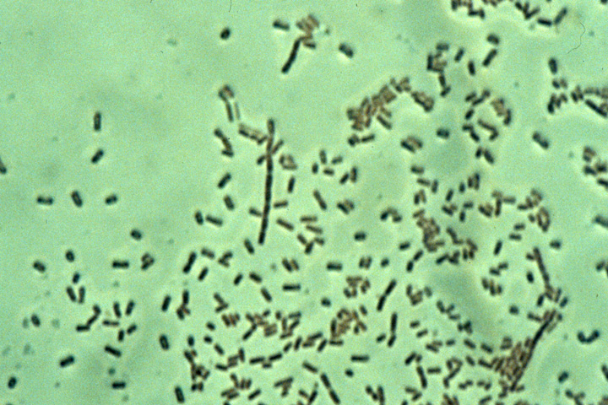
Soil Bacteria
Photo Credit: Michael T. Holmes, Oregon State University, Corvallis.

Slide 9
Bacteria
Bacteria help rot dead plants and animals to recycle nutrients into plant food.
They help make nitrogen (a plant food) for plants.
Some live free in the soil; others grow on the roots of plants (legumes).

Slide 10
Bacteria
One cup of soil can hold as many bacteria as there are people on Earth
That’s over 6 billion!
The weight of all bacteria in 1 acre (about the size of a football field) can equal the weight of one or two cows.

Slide 11
Fungi
Grow in long threads called hyphae.
Fungi help plants get food and water from the soil.
Other fungi help rot dead plants to recycle nutrients.

Slide 12
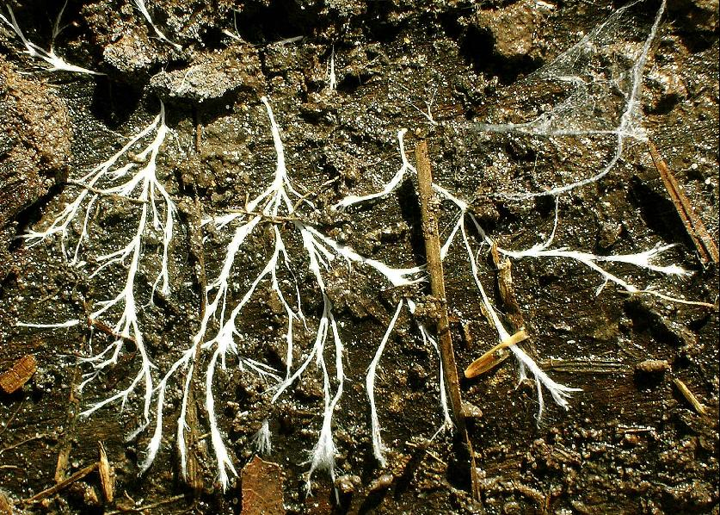
Hyphae of Fungi
Fungal hyphae, http://serendip.brynmawr.edu/exchange/wfrankli/classification.problem/mycology

Slide 13
Fungi
A teaspoon of farm soil or grassland may contain tens of yards of fungi.
The same amount of soil from a coniferous forest may hold tens of miles of fungi.

Slide 14
Some fungi produce large above ground structures.

Slide 15
Actinomycetes
Have cells like bacteria, but grow in threads like fungi.
Help degrade tough materials, like cellulose, for bacteria to further degrade.

Slide 16
Actinomycetes
Source of the antibiotic Streptomycin.
Produce geosmin – that wonderful “earthy” smell of fresh plowed ground.

Slide 17
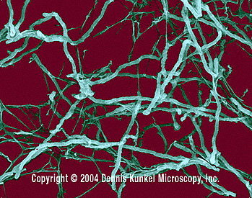
Actinomycetes

Slide 18
Protozoa
Are tiny animals that feed on bacteria and move through the soil.
When they eat bacteria, they help release nutrients for plants to use.
Some live in termite guts and help digest wood fibers.

Slide 19
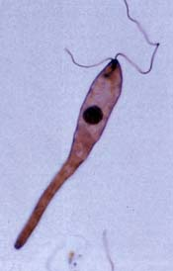
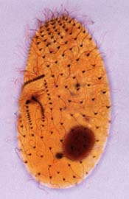
Protozoans
Flagellate soil protozoa. Ciliate soil protozoa eat tens of thousands of bacteria daily.
Photo credit: Wilhelm Foissner, Institute of Zoology, University of Salzburg

Slide 20
Nematodes
Tiny roundworms that are common in farm or grassland soils.
Some are serious pests, but many help provide plant food for plants
They help mix up the soil.
5,000 soil species have been described.

Slide 21
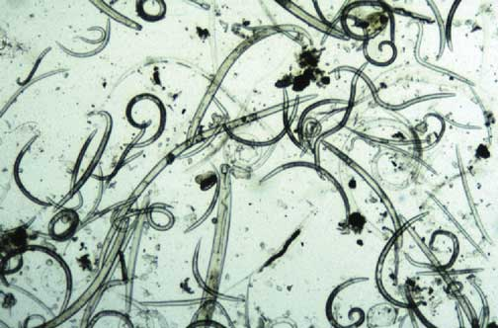
Nematodes
Plant-parasitic and non-parasitic nematodes recovered from soil by sieving. (Greg Tylka)

Slide 22
Arthropods
Don’t have a backbone, but do have jointed legs.
They include ants, termites, spiders, mites, centipedes, millipedes and many others.
They stir up the soil so it gets more air and moves nutrients around.

Slide 23
Arthropods
They chew up dead plants into tiny pieces for bacteria and fungi.
When you take a step in a forest, you are being held up on the backs of thousands of bugs.
How cool is that?!!!!!!!

Slide 24
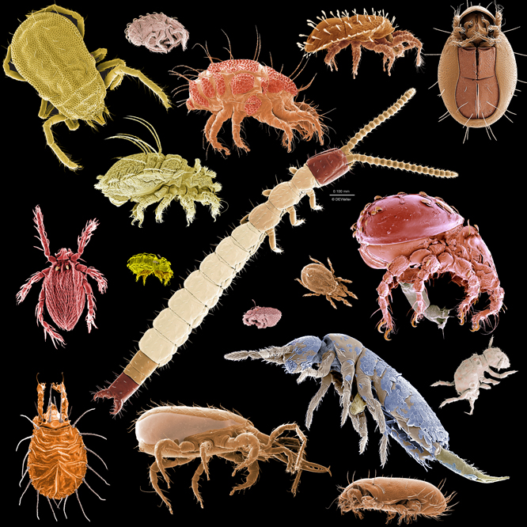
Arthropods
Image source : http://macromite.wordpress.com/2009/04/29/a-menagerie-of-microarthropods

Slide 25
Earthworms
Some live on the surface in leaf litter, some lie just beneath the surface, some burrow deep in the soil.
As they move around, they move organic material from the soil surface to the lower layers.

Slide 26
Earthworms
They also create cavities for air and water to move.
Where earthworms are active, they can turn over the top 6 inches of soil in 10-20 years.

Slide 27
Earthworm
© Robert Pickett/Corbis

Slide 28
Organisms living in soil

Slide 30
The End
Thank you!

