Slide 1
Let’s Talk Trash !
Where it all began,,,

Slide 2
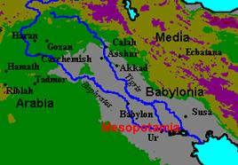
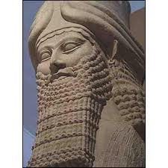
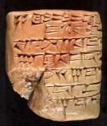
King Sargon
KING SARGON
Scholars once claimed that no Assyrian King Sargon ever lived, because the Bible was THE ONLY record of such a person. “In the year that Tartan came to Ashdod, when Sargon the king of Assyria sent him, and he fought against Ashdod and took it…” - Isaiah 20:1.
King Sargon’s palace was discovered in Khorsabad, Iraq. The very event recorded in Isaiah 20-his capture of Ashdod-was recorded on the palace walls.

Slide 3
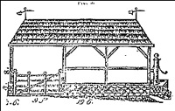
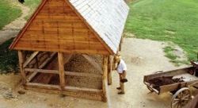
George Washington, Composter-in-chief

Slide 4
Ask yourself some questions???
Am I patient?...
Or Type ‘A’?
What do I want to do with my finished compost?
Why do I want to compost?
How much work is involved?
Cost???
Location???
Style???
Water source???

Slide 5
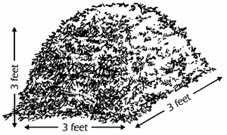
Heaps…Pile it up!!!
You can create a compost pile in your backyard depending on your available space and usable product. This can take up to two years to complete, just block off space and “Pile it up!!! “

Slide 6
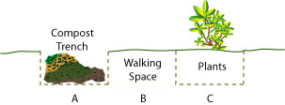
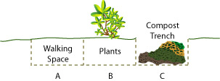
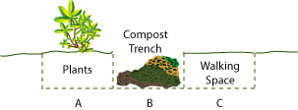
Pit Trenching
Year 1 – Dig a 1’ foot wide trench on the left hand 1/3 of the 3’ area (A). Add compostable materials in this trench and cover with soil when half an inch full. Leave the center 1’ section open for a path (B), and plant your crop in the remaining 1’ strip along the right side (C).
Year 2 – Section A is a path for year 2 allowing time for the Materials to break down. Plant your crop in section B. Section C, where you planted last year, becomes the compost trench.
Year 3 – Section A is now ready for planting. Section B is your trench for composting. Section C is in the second year of composting is it will be the path.

Slide 7
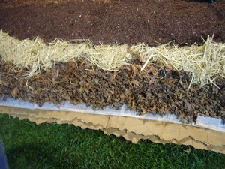
Sheet Composting
Don’t bother to dig, level or weed! That’s sheet mulching. Definitely the Guerilla Gardeners way to a quick garden without the back breaking labor you get when starting a new garden from scratch. Think Lasagna…make layers:
Wet Weed & Seed Free
Finished Compost
Clean Straw or Sawdust
Wet Leaf Mold (last year’s leaves) or Wet Raked Leaves
Wet Cardboard and/or Newspaper

Slide 8
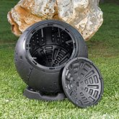
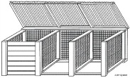
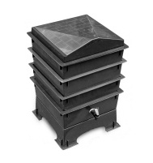
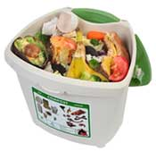
Compost Tumbler A compost tumbler has an internal mechanism designed to move or adjust/aerate the compost pile by turning or rotating the central bin, typically on a stand. Composting Bins A composting bin is a fixed position, freestanding bin that needs to have the contents manually moved or adjusted (normally with an aerator) to aerate the compost pile. Worm Composters Worm composters are self-contained composters that don't generate heat. Red worms feed on yard waste, fruit and vegetable trimmings. Properly maintained, worm composters are odorless and can be used year round. Kitchen Composters Designed to sit right on the counter or next to your regular trash bin, kitchen composters are perfect for composting on a smaller scale. A kitchen composter often looks like a simple, non-descript bucket.

Slide 9
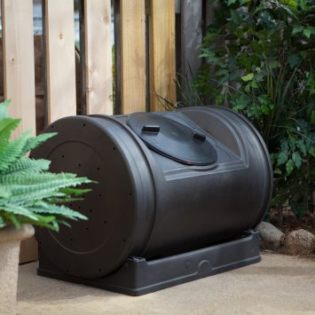
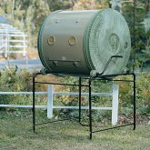
Turning Units

Slide 10
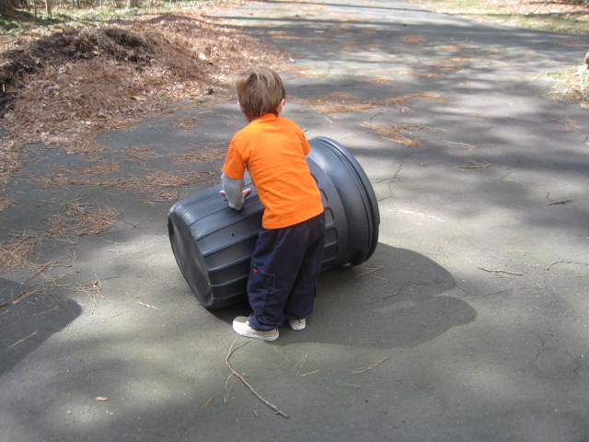
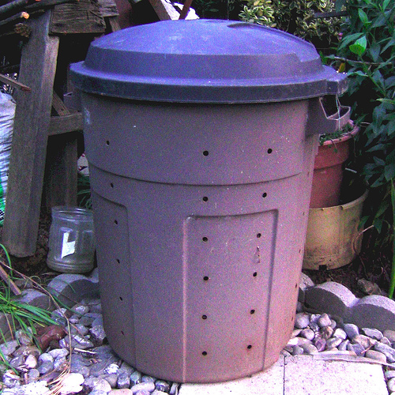
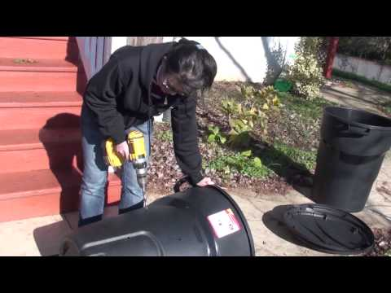
Patio Composting

Slide 11
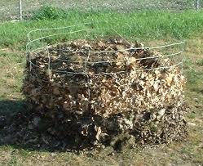
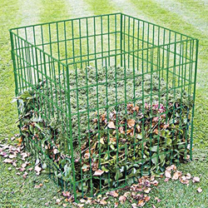
Cubit Yard Wire Bin

Slide 12
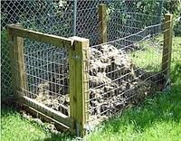
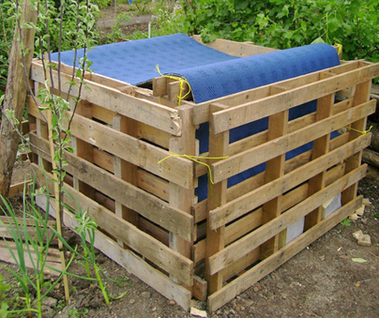
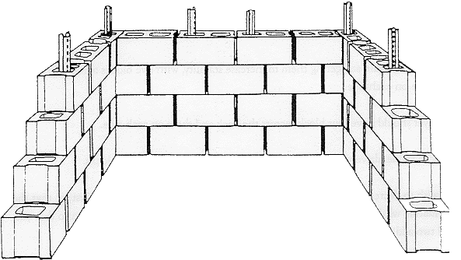
Use what you have on hand…

Slide 13
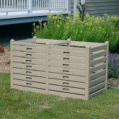
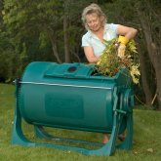
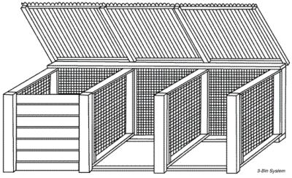
Multi-Step Bins

Slide 14
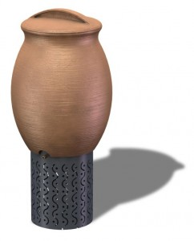
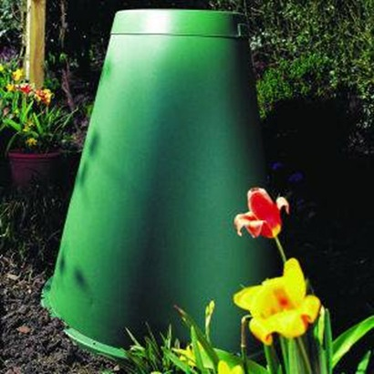
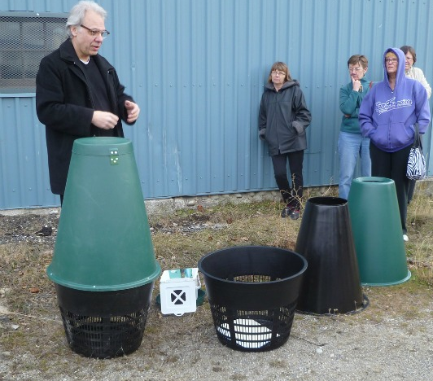
Green Cone &
Algreen’s Solar Digester Systems

Slide 15
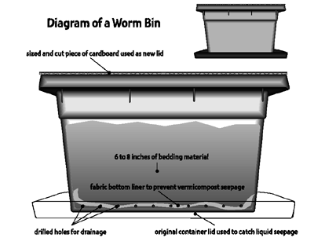
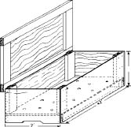
I’ve got worms!

Slide 16
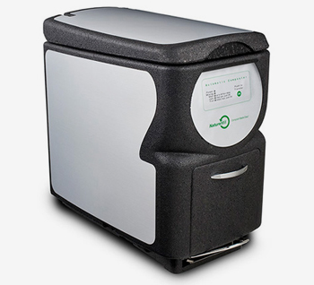
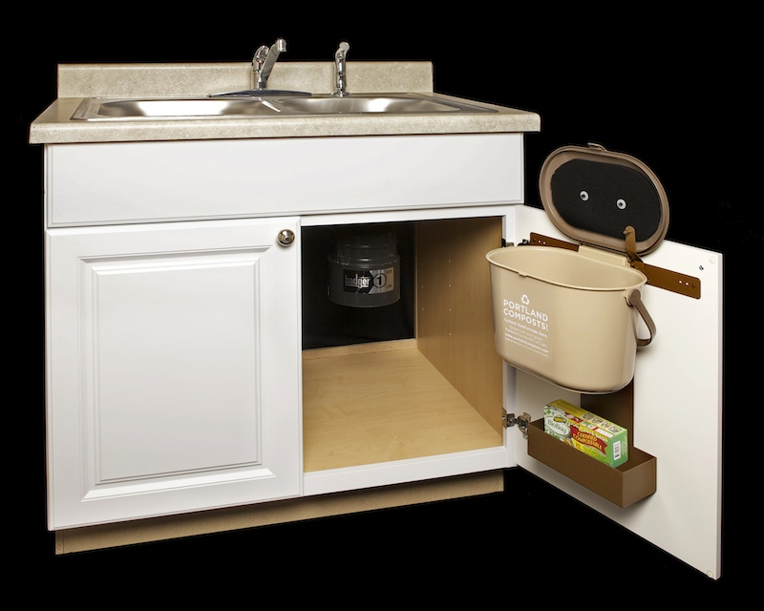
Kitchen Composter

Slide 17
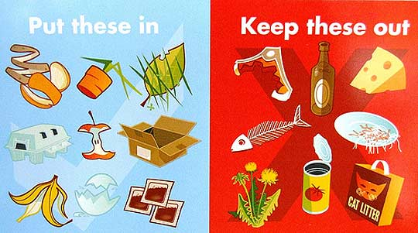
Trouble shooting problems In Your compost

Slide 18
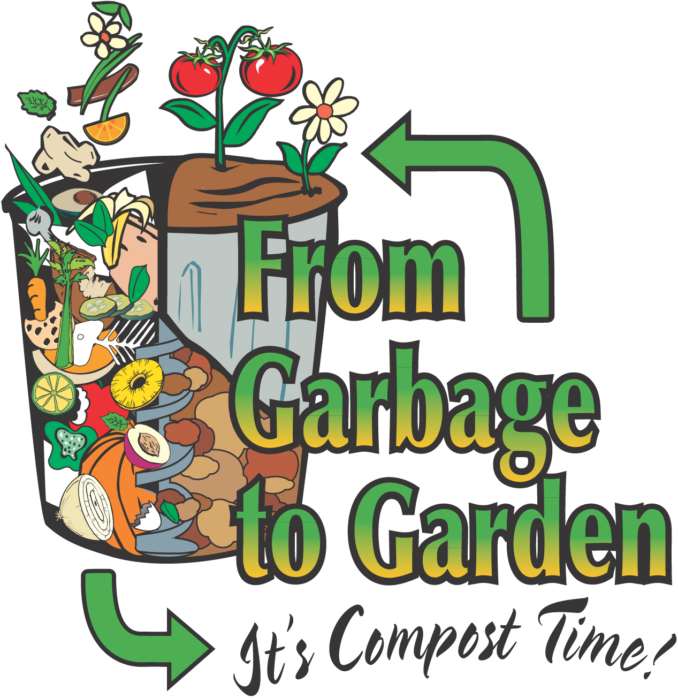
Get the most outta compost!

Slide 19
I compost What’s your
Super power???

