Slide 1
Using this Gardeners Black Gold
Brian Jervis
Tulsa County Extension Educator
Oklahoma State University

Slide 2
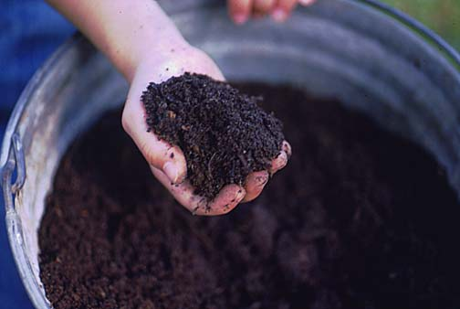
Is it ready yet?
Ready to use when:
Temps within pile begin to cool and remain steady even after turning pile
Dark color and earthy smell
You just know!
Get it in the ground!

Slide 4
Benefits of Compost Soil Amendment
Composts (Organic Matter) Builds Soil Structure
Improve drainage
Water holding capacity
Retain nutrients better

Slide 5
Benefits of Compost Soil Amendment
Amount
50 to 100 Lbs per 100 Square
2 to 6 inches
Incorporate in soil
As deep as the plant roots, usually 6 inches
Adding Organic Matter
Helps break up the clay soils

Slide 6
Benefits of Compost Soil Amendment
Add Nutrients
Nitrogen
Phosphorus
Potassium
Micronutrients
Manganese, Copper, Iron and Zinc

Slide 7
Benefits of Compost
Feeds and supports living things in the soil
Living soil that contains beneficial organisms tends to be more productive
Diverts organic waste
Exercise

Slide 8
Benefits of Compost Mulch
Best single item to use in your landscape
Conserves Moisture
Maintains Temperatures
Weed Control
Physical Protection

Slide 9
No Weeds = Faster Growth and Bigger Trees
Keep a five foot diameter circle free of grass and weeds.
Grass control most important
Herbicides
SETHOXYDIM
Poast (Hi-Yield)
FUSILADE
Grass-B-Gon (Ortho)
Over-The-Top Grass and Weed Killer (ferti•lome)
GLYPHOSATE
Roundup (Monsanto)
Killzall (ferti•lome)

Slide 10
OSU Soil Testing
Routine Soil Tests are $10.00
N, P, K and pH
We can also test for Micro and Secondary Nutrients
Soil Organic Matter, Texture and Salinity

Slide 11
OSU Soil Testing
10 to 14 day turn-a-round
Samples need to be somewhat dry, free of sticks and rocks
15-20 mini samples per area
Bring us a pint
We mail the results

Slide 12
Be Aware
Using “unfinished” compost could use up available nutrients from the plant
Too Many Nutrients
Too Much Salt
Lawns treated with herbicide
Know what was applied and when
Read the Label

Slide 13
Questions?

