Slide 1
Composting Dynamics
The natural cycle of life, death and rebirth Composition, decomposition, recomposition
MetRecycle.com | TulsaMasterGardeners.org | CompostEverything.net

Slide 2
Composition---building blocks of life. The combining of distinct parts or elements to form a whole.
Life---phenomenon of having metabolism, growth, reproduction, and adaptation to environment.
Decomposition---to break down (organic matter) physically and chemically by bacterial or fungal action.
Death----the cessation of all vital functions of the body including the heartbeat, brain activity (including the brain stem), and breathing.

Slide 3
Recomposition---to compose again; reorganize or rearrange.
Rebirth--- a renewed existence, activity, or growth

Slide 4
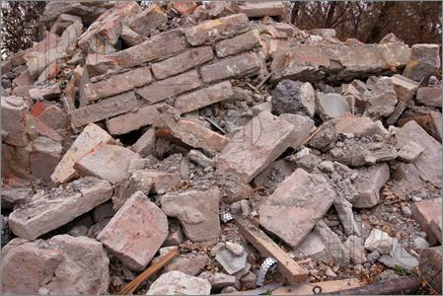
Building Blocks: Assembling Disassembling

Slide 5
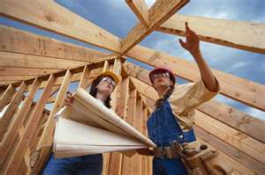
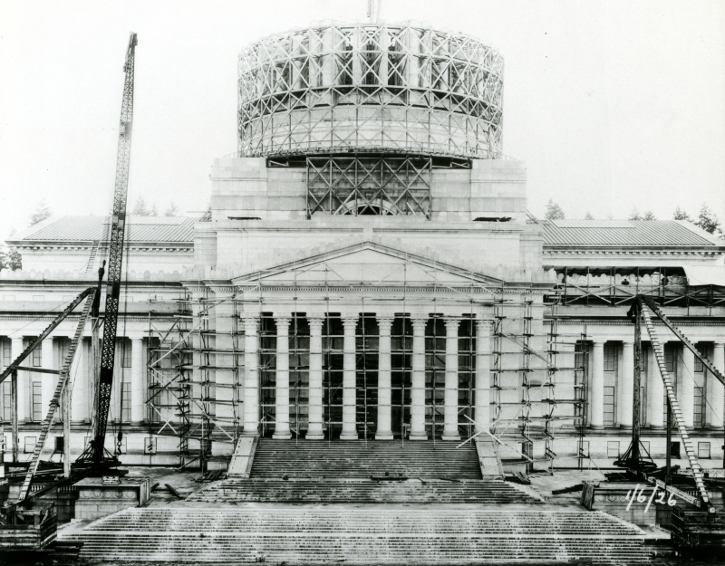
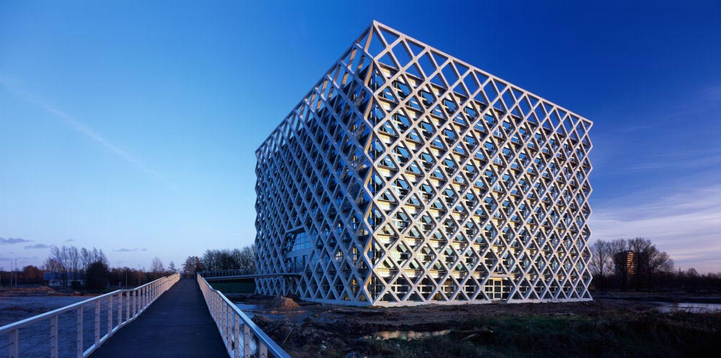
Construction

Slide 6
Decomposition
Decomposition is the natural process by which large organic materials and molecules are broken down into simpler ones. The final products of decomposition are simple molecules, such as carbon dioxide and water.

Slide 7
If decomposition did not occur, the world would be overcome with Himalayan piles of dead, chiefly unusable materials.

Slide 8
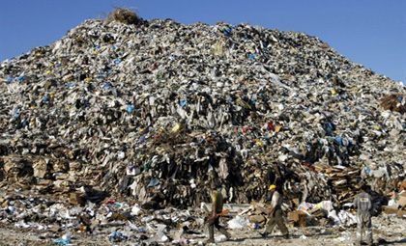

Slide 9
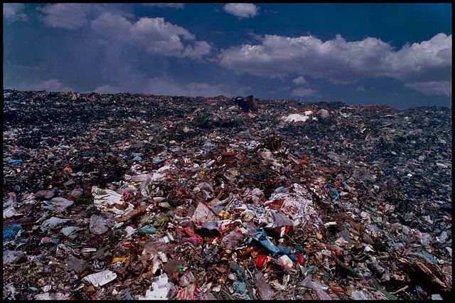

Slide 10
Wrecking Balls to Complex Structures
Water
Sunlight/ Heat
Microorganisms
pH
Other organic material
Earth worms

Slide 11
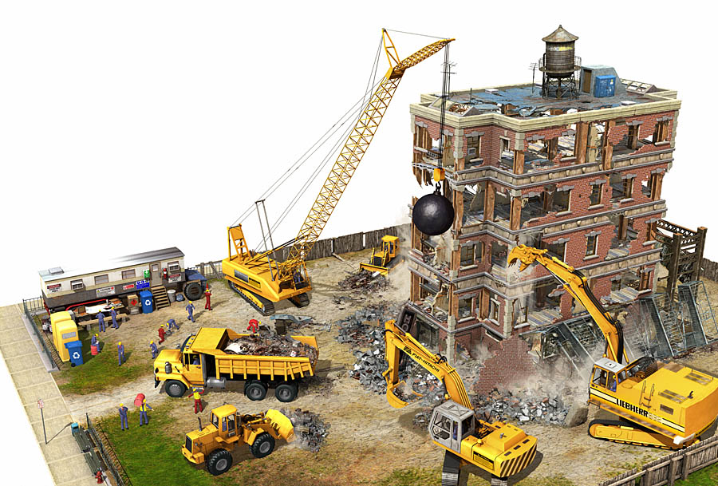
Deconstruction/Demolition

Slide 12
Everyday used items—how do we recreate with them??
Composting
Recycling
Landfill
Feed to animals

Slide 13
Things I used last week
Banana peel
Plastic bottle
Coffee grounds
Steel dog food can
Strawberry hulls
Empty paper horse food bag
Toilet paper and paper towel rolls
Tulsa World
Potato chip bag
Candy wrapper
Tree branch pruning's
Old torn up towels and sheets

Slide 14
Composting items
Carbon-rich “browns” – dry materials such as wood
chips, dried leaves, sawdust, straw
Nitrogen-rich “greens” – fresh, moist materials such
as grass cuttings, fruit and vegetable scraps,
coffee grounds, eggshells, spent flowers and
plants and soft pruning's from the garden.

Slide 15
Decomposition times
Banana Peel: 3-4 weeks
Paper Bag: 1 month
Cardboard: 2 months
Wool Sock : 1 year
Tinned Steel Can: 50 years
Aluminum Can: 200-500 years (But if recycled, it can be reused within 6 weeks!)
Disposable Diapers: 550 years
Plastic Bags : 20-1000 years
Plastic Jug: 1 million years
Glass : 1-2 million years
Styrofoam: 1+ million years

Slide 16
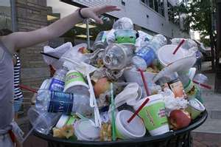
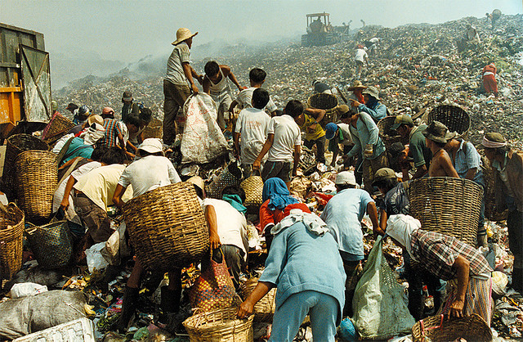
What to do? Who to call?
We have options/choices

Slide 17
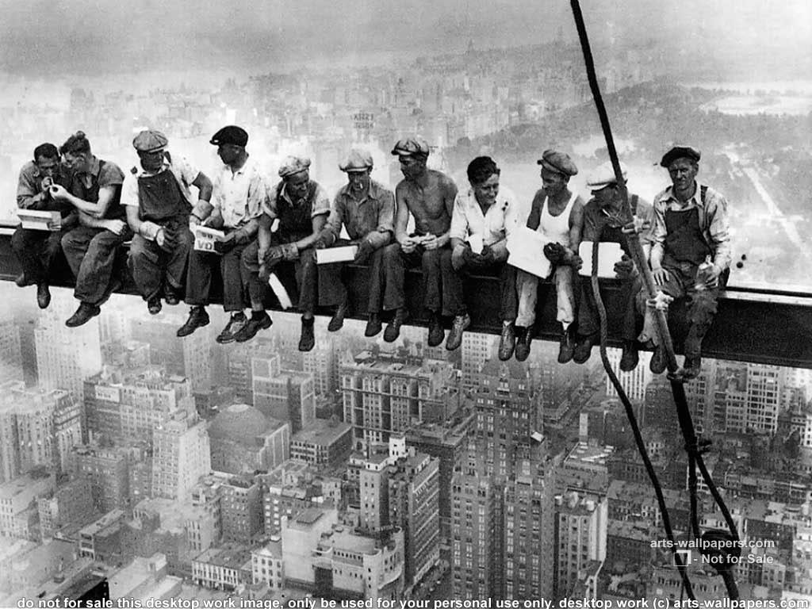

Slide 18
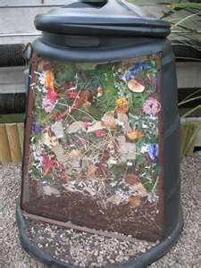
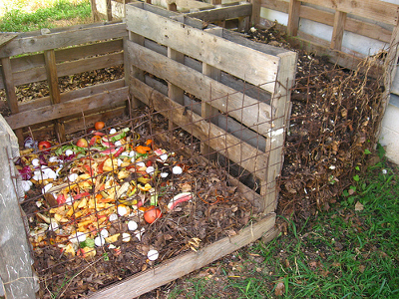
The Non-military Cavalry: Recycling and Composting

Slide 19
(Wo)Mankind and Worms
Heroes of the Earth
All shapes and sizes with similar traits

Slide 21
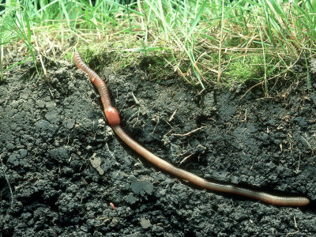

Slide 22
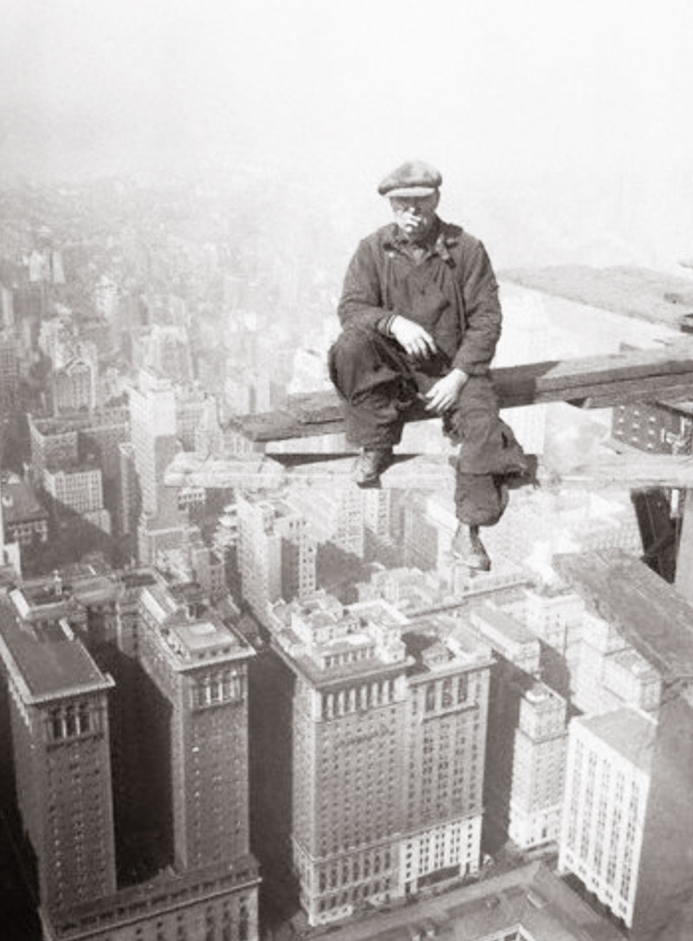
No where to go?
We have a choice

Slide 23
Numbers to call to receive help on where to send or how to utilize your refuse in an environmentally friendly socially responsible way.
Email the Met: met@metrecycle.com or check out their website http://metrecycle.com/
Contact Master Gardeners (918) 746- 3701 www.tulsamastergardeners.org
If you still need help call the Mayors Action Line
(918) 586-2100

