Slide 1
Composting Dynamics
Compose to Decompose to Recompose
Construct to Deconstruct to Reconstruct
MetRecycle.com | TulsaMasterGardeners.org | CompostEverything.net

Slide 2
Composition
a. The combining of distinct parts or elements to form a whole.
b. The manner in which such parts are combined or related.
Decomposition
a. to break down (organic matter) physically and chemically by bacterial or fungal action; rot
b. to break down or cause to break down into simpler chemical compounds

Slide 3
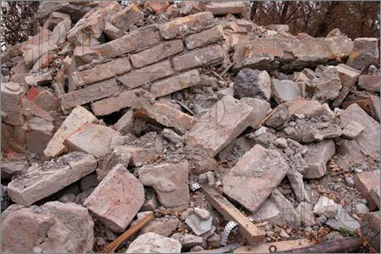
Building Blocks: Assembling Disassembling

Slide 4
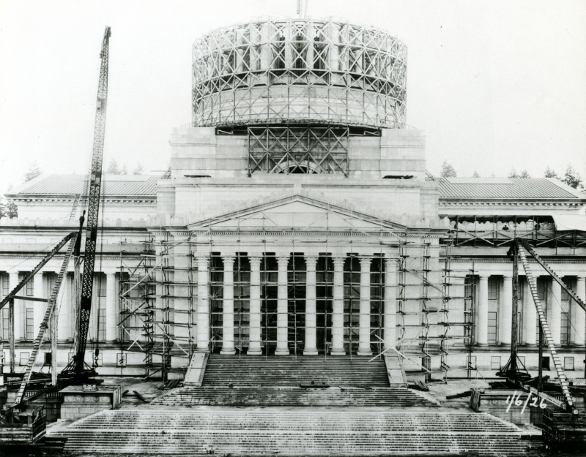
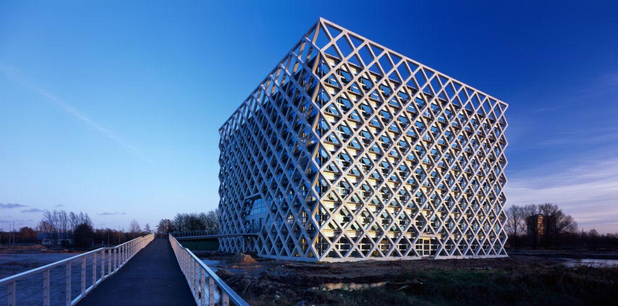
Construction

Slide 5
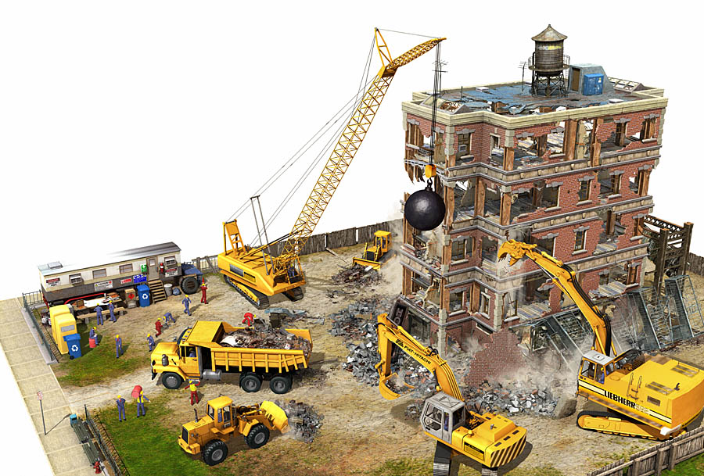
Deconstruction/Demolition

Slide 6
Decomposition
Decomposition is the natural process by which large organic materials and molecules are broken down into simpler ones. The final products of decomposition are simple molecules, such as carbon dioxide and water.

Slide 7
If decomposition did not occur, the world would be overcome with Himalayan piles of dead, chiefly unusable materials.

Slide 8
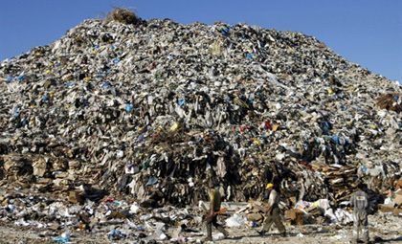

Slide 9
Decomposition times
Banana Peel: 3-4 weeks
Paper Bag: 1 month
Cardboard: 2 months
Wool Sock : 1 year
Tinned Steel Can: 50 years
Aluminum Can: 200-500 years (But if recycled, it can be reused within 6 weeks!)
Disposable Diapers: 550 years
Plastic Bags : 20-1000 years
Plastic Jug: 1 million years
Glass : 1-2 million years
Styrofoam: 1+ million years

Slide 10
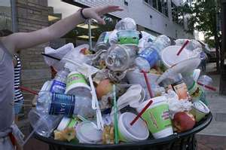
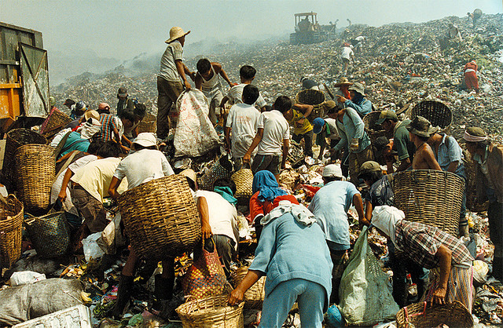
What to do? Who to call?

Slide 12
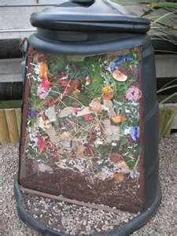
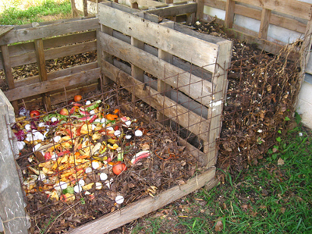
The Non-military Cavalry: Recycling and Composting

Slide 13
Wrecking Balls to Complex Structures
Water
Sunlight/ Heat
Microorganisms
pH
Other organic material
Earth worms

Slide 14
(Wo)Mankind and Worms
Heroes of the Earth
All shapes and sizes with similar traits

Slide 16
